Slide 1

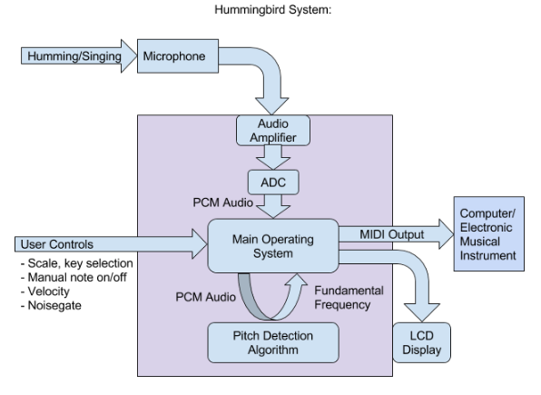
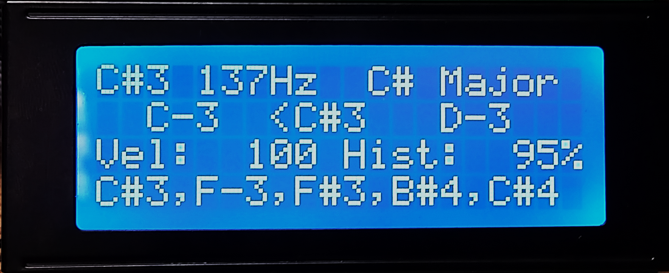
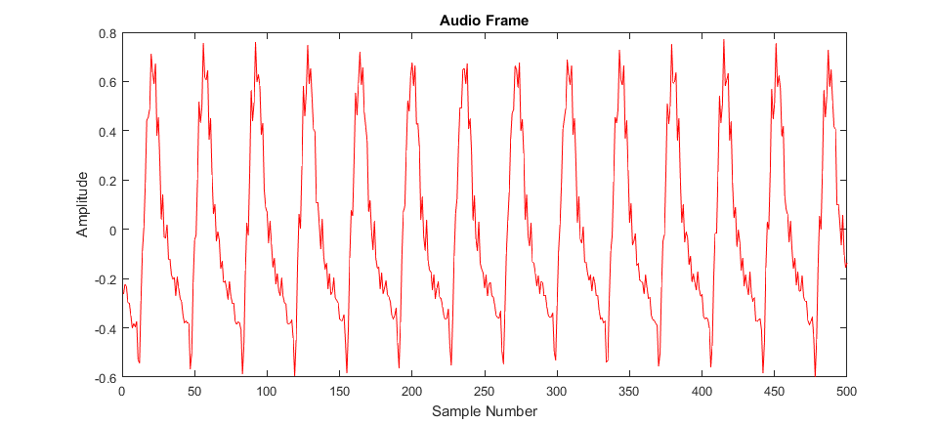
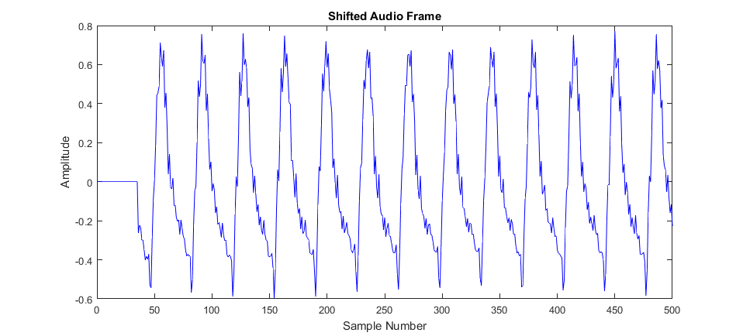
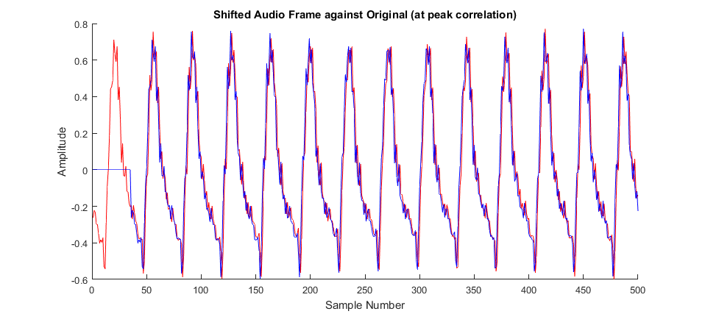
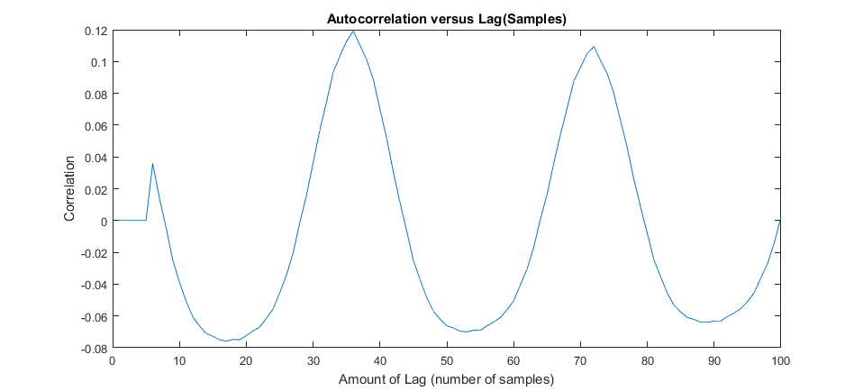
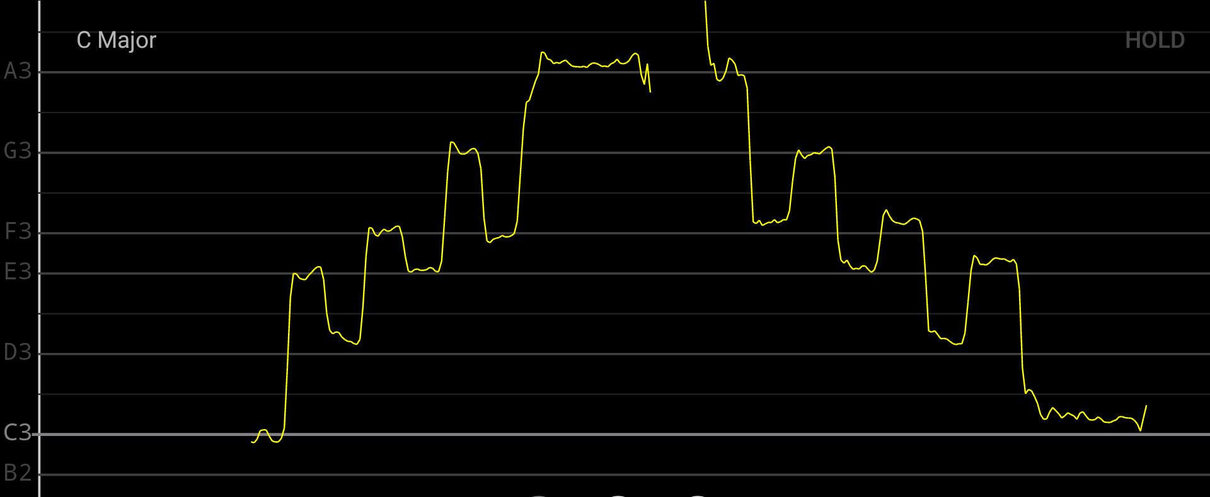
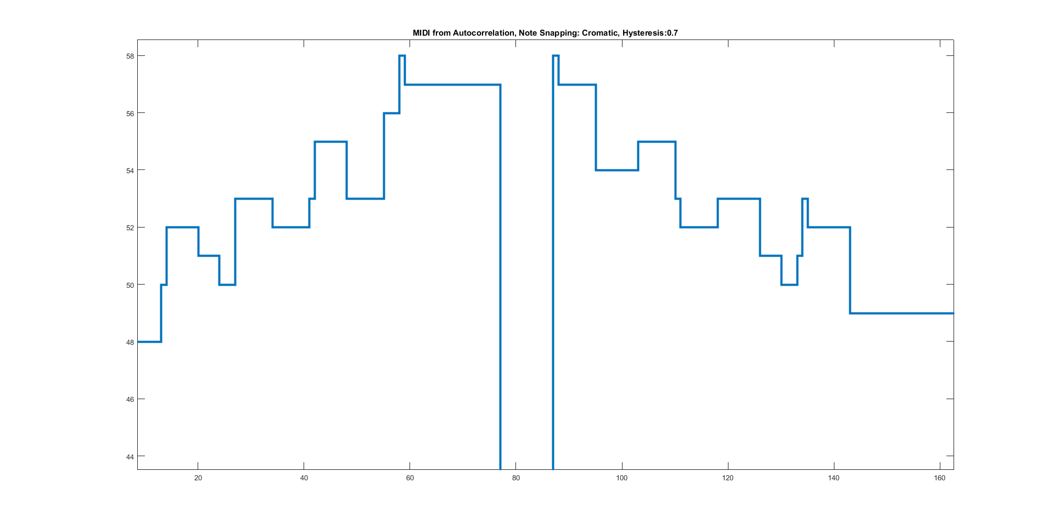
Hummingbird: Acoustic Control for Electronic Musical Instruments
Joey Devoto, Marcus Gronberg, Andre Marquez, Jason Vance
Abstract
Overview
Analysis
The Hummingbird is a music tool that allows the user to play musical instruments and compose music by humming. Instead of using hands to manually play an instrument (like striking keys on a piano), the user hums their melody into a microphone. This audio is processed using a pitch detection algorithm in real-time (less than 80ms of delay between humming the note and output). This pitch is converted into MIDI (Musical Instrument Digital Interface) data, which can be used to play any digital instrument (hardware keyboard, synthesizer) or record and play on a Digital Audio Workstation (Ableton Live, Fl Studio, etc.).
Algorithm Selection:
Note Snapping and Hysteresis:
Output from the PDA is fed into a “note snapping” function in which pitches are restricted to a predetermined set of frequencies correlating to musical scales. Currently, the Hummingbird system is capable of processing music for the Chromatic, Major, Minor, Major Pentatonic, Minor Pentatonic, Blues, and Whole Tone scales.
To Improve the accuracy of the MIDI output, the frequency of each new frame is compared to the last, and must exceed a specific threshold before a different note is output. This hysteresis method prevents virbratio and other inaccuracies from dissociating what the user expects from the actual output.
Microphone data is sampled in real time, and temporarily written into one of two buffers, which we call data frames. Data frames have a length of 256 samples, and each sample has a resolution of 12 bits. The idea of having two data frames is so that one is readily available to be processed, while the other is being “filled” with new samples.
To extract the musical information from this audio, we implement a pitch detection algorithm to find the fundamental frequency of each frame. This fundamental frequency (which is a single numeric data value) is passed back to the main program, which translates the frequency into its associated musical note (A, B#, G, etc). This note can be placed into a MIDI message, which is sent out of the system to an electronic instrument or computer with digital music software.
 | Pros | Cons
FFT | Accurate Hz detection | Very slow (~200ms lag) Algorithm of O(n^2)
Zero Crossing | Very fast | Inaccurate Hz detection Has trouble picking up the lower 20% of notes
Auto Correlation | Accurate
Approach
Platform(PSOC)
Pitch Detection Algorithm (PDA):
The PDA is the “heart” of the project, so this is where a lot of time was spent researching, testing, and refining. Our main goals for the algorithm were simple: accurate and fast. FFT (fast Fourier transform), YAAPT (Yet Another Algorithm for Pitch Tracking), zero-crossing, and autocorrelation. Ultimately, we chose to implement our design using autocorrelation method as it proved to be the best balance between pitch accuracy and processing time.
Audio Acquisition:
-Microphone Amplification:
The signal from the mic is fed into an analog amplification circuit before it is captured by the PSOC ADC. The circuit amplifies the signal to the appropriate voltage level for the ADC. this allows the PSOC ADC to read the largest signal possible, which produces a clear digital signal.
- Analog to Digital Conversion:
Analog to digital conversion of the amplified microphone signal is preformed using the onboard successive approximation ADC. This method was chosen over the Sigma-Delta ADC because the SAR method offers lower power consumption and latency.
- Pitch Detection Algorithm:
The input audio is sampled at a rate of 8000 samples per second, which are processed by the pitch detection algorithm as individuals 500 sample “frames”. The fundamental frequency of each frame is processed using autocorrelation, converted into a MIDI note, and output over USB or standard MIDI port.
Note, Frequency, Key/Scale
Tuner
MIDI Velocity, Hysteresis
Previous Notes
Results
24-30 pt Font only
Conclusion
Acknowledgments
24-30 pt Font only
We would like to credit the completion of this project to our one true god – the BASED GOD known as Lil B. Homeboy done fucked my bitch.
Logos of other financial assistance can go here as well (if logo exist)

